Slide 1
Web Storage
Notes:
The Web Storage API allows a Web page to store data client-side, either for the duration of the current session or persistently after the browser window has closed. This is ideal for Web applications that have intermittent connectivity, e.g. on a mobile device, where it's infeasible to keep posting data up to the server.

Slide 2
Contents
Overview of HTML5 Web Storage
Understanding the Web Storage API
Listening for storage events
Offline working
Demos folder:
Demos\12-WebStorage
Notes:
Section 1 explains the core concepts of Web Storage, and describes the two different types of storage available (essentially, persistent and non-persistent).
Section 2 covers the Web Storage API in detail. It's a fairly intuitive API, with operations to add an item to Web storage, look-up an item, remove an item, etc.
Section 3 shows how to handle events, indicating that an item has been added, removed, or modified in Web Storage. We'll also explain why this is useful.
Section 4 covers offline working. This isn't a Web Storage mechanism, but it's a related topic. Offline working makes it feasible for a Web page to operate meaningfully even if there's no Internet connection available.

Slide 3
1. Overview of HTML5 Web Storage
Recap of cookies
The HTML5 Web Storage approach
Categories of Web Storage
Checking for support
Notes:
This section sets the scene for the chapter. We'll explain the need for Web Storage, describe the two types of Web Storage available, and show how to detect if a browser supports Web Storage.

Slide 4
Recap of Cookies
HTML5 Web Storage is a successor to cookies
So it makes sense to discuss cookies first ☺
Cookies are a well-established way to exchange small pieces of data between client and server
Can be persisted (for a specified lifetime) on client's computer
Typically used to store user ID, etc.
Have a scope (domain, application, page)
Limitations of cookies
Very limited in size (~4KB per cookie)
Transmitted back-and-fore on every request scoped for that cookie
Notes:
Cookies give some support for persistence in a Web page. You can create a cookie in JavaScript and store it on the local drive. Likewise a Web server can return a cookie to the browser, and the browser can store it locally on the browser computer.
However, cookies are not designed to hold large amounts of data. Cookie space is very limited, and is only really meant to hold snippets of information such as user IDs. Cookies do not remove the need for real persistence at the server.

Slide 5
The HTML5 Web Storage Approach
In many cases where cookies are used traditionally, the same effect could be achieved without using a network
This is where the HTML5 Web Storage API comes in…
Developers can use the HTML5 Web Storage API to store values in local JavaScript objects
The objects persist across page loads
Additional notes:
Stored data is not transmitted across the network
Very large values can be stored (e.g. ~MB)
Notes:
HTML5 introduces the notion of Web Storage, which allows a Web application to store large amounts of data locally.
The intention is to allow Web pages to be largely self-supporting, even in the absence of Internet connectivity. A Web page can store data locally while disconnected, and then send the data to the server if and when a connection becomes available.

Slide 6
Categories of Web Storage
Local storage
Accessible via window.localStorage
Values are persisted even after you close the browser window
To remove items from local storage, you must do so explicitly via JavaScript code (or if the user clears the browser’s cache)
Values are accessible from the domain that initially stored the data
Session storage
Accessible via window.sessionStorage
Values are discarded when the browser or tab is closed
Values are accessible only from the page that stored the data
Notes:
Local storage is persistent; when you close the browser window, local storage is persisted to an appropriate (browser-specific) folder on the local computer.
Session storage is transient; as soon you close the browser window, session storage is lost. This is still useful though; it allows a Web application to cache a lot of data locally while it's running, without having to constantly re-synch with the server.

Slide 7
Checking for Support
You can easily check for Web Storage support
See TestWebStorageSupport.html
<script>
…
var localStorageMessageArea = document.getElementById("localStorageMessageArea");
var sessionStorageMessageArea = document.getElementById("sessionStorageMessageArea");
if (window.localStorage) {
localStorageMessageArea.innerHTML = "Browser DOES support localStorage";
} else {
localStorageMessageArea.innerHTML = "Browser DOES NOT support localStorage";
}
if (window.sessionStorage) {
sessionStorageMessageArea.innerHTML = "Browser DOES support sessionStorage";
} else {
sessionStorageMessageArea.innerHTML = "Browser DOES NOT support sessionStorage";
}
…
</script>
Notes:
If a browser supports Web storage, then the window.localStorage and window.sessionStorage properties will be defined. You can check these properties as shown in the slide.
Note that for predictable results, you should download your Web pages from a Web server rather than opening them directly from the file system. This is because the browser needs to know the domain from which the Web pages were loaded, so that it can keep Web Storage from different domains separate. The local file system doesn't have a domain as such, so if you open Web pages from the local file system, the browser might not allow the Web pages to access Web Storage.

Slide 8
2. Understanding the Web Storage API
Overview
Getting and setting a value
Obtaining a count of items
Removing items
Iterating all items
Worked example
Notes:
This section explains the Web Storage API for adding items to local storage or session storage, removing items, looking up items, etc.

Slide 9
Overview
sessionStorage and localStorage offer exactly the same APIs
Both implement the Storage interface
We'll show how to use the capabilities of the Storage interface
The example would be syntactically the same, whichever category of storage we chose to use ☺
Notes:
The sessionStorage and localStorage objects both implement the Storage interface, so the APIs for both these objects are exactly the same.
The following slides show examples of localStorage, but the examples would be just the same for sessionStorage.

Slide 10
Getting and Setting a Value
There are several ways to get a value from web storage...
E.g. to get an item named "count" from local storage:
There are several ways to store a value in web storage…
E.g. to store an item named "count" in local storage:
Example:
See AccessingWebStorage.html
var i = window.localStorage.count;
var i = window.localStorage.getItem("count");
var i = window.localStorage["count"];
window.localStorage.count = i;
window.localStorage.setItem("count", i);
window.localStorage["count"] = i;
Notes:
Web Storage is like a dictionary. Items are held as name/value pairs. It's a very simple model ☺.
The upper code box shows several ways to get a value from local storage. In the example, we're trying to get an item named count from local storage.
The lower code box shows how to store an item in local storage. It there's already an item named count, it will be overwritten with the new value. If there isn’t yet an item named count, then it will be inserted now.
Note: All the code in the slide would be just the same for session storage; just replace localStorage with sessionStorage in the code.

Slide 11
Obtaining a Count of Items
You can get the number of items in web storage
E.g. to get the count of items in local storage:
var count = localStorage.length;
Notes:
The length property tells you the number of items currently in local storage (or session storage, as appropriate).

Slide 12
Removing Items
You can remove a particular item from web storage
E.g. to remove an item named "count" from local storage:
You can clear all items in web storage
E.g. to clear all items from local storage:
localStorage.removeItem("count");
localStorage.clear();
Notes:
The removeItem() method removes the item with the specified name from local storage (or from session storage, as appropriate).
The clear() method removes all items from local storage (or session storage, as appropriate).

Slide 13
Iterating all Items
You can iterate through all the items in web storage
Iterate over the keys, and get the value for each key
E.g. to iterate over all the items in local storage:
var count = localStorage.length;
for (var i = 0; i < count; i++) {
var key = localStorage.key(i);
var val = localStorage[key];
alert(key + "=" + val);
}
Notes:
If you want to access all the items in local storage or session storage, iterate over all its keys and get the value corresponding to each key. It's a classic dictionary programming API!

Slide 14
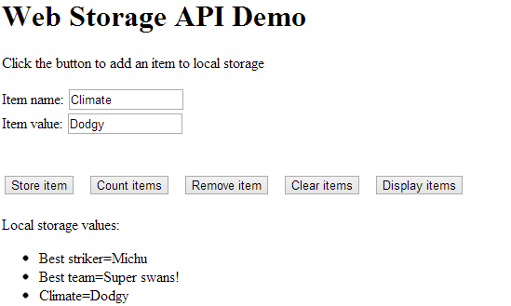
Worked Example
For a worked example, see the complete code in the following file:
WebStorageApi.html (use Chrome, IE, Firefox, etc.)
Notes:
This demo shows a complete example of Web Storage. The example pre-populates local storage with a couple of initial items, and then allows the user to store new items, get the count of items, remove an item, clear all items, and display all items.

Slide 15
3. Listening for Storage Events
Overview
Handling storage events
Worked example for local storage
Notes:
This brief section describes the events that occur whenever anything happens in Web Storage, and shows how to handle such events.

Slide 16
Overview
The data stored in local storage is available to any document that has the same origin
The storage event is triggered when one document makes a change to the storage
We can listen to this event in other documents that were loaded from the same origin
Allows documents to stay abreast of changes
Notes:
When you download a Web page from a Web server, the browser keeps a record of its origin, i.e. its domain and schema (e.g. http or https). If the Web page changes anything in Web storage, the browser raises a storage event.
Any currently-loaded Web pages from the same origin will see storage events, and can handle these event to ensure they stay abreast of the latest state of relevant data in Web Storage.

Slide 17
Handling Storage Events
This is how you handle the storage event for local storage:
Properties on the eventStorage object:
key - indicates the key that's changed
oldValue - old value for key (may be null)
newValue - new value for key (may be null)
url - URL of the document that made the change
storageArea - local/session storage object that's changed
window.onstorage = handleStorage;
function handleStorage(eventStorage) {
// eventStorage parameter gives information about the change in storage…
}
Notes:
Handling the storage event is simple. Just set the window.onstorage property to your event-handler function. Note that there's only one storage event, which caters for changes in both local storage and session storage.
The event-handler function receives an eventStorage object as a parameter, indicating which item has changed, its old/new values, the URL of the document that made the change, and the storage area in which the item is held (i.e. window.localStorage or window.sessionStorage).

Slide 18
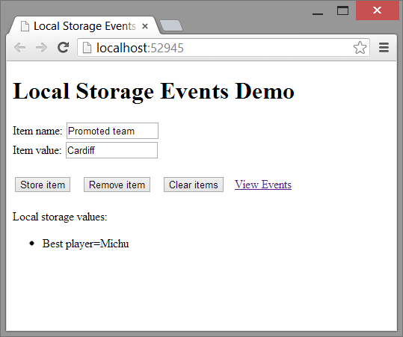
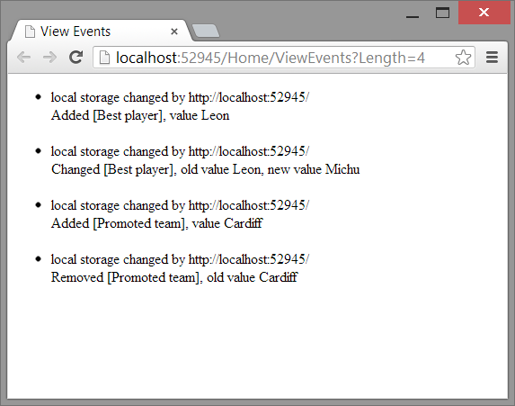
Worked Example for Local Storage
For an example of storage events for local storage, see the StorageEvents demo
Index.cshtml allows you to add/remove/clear items
ViewEvents.cshtml handles storage events
Similar idea for session storage (within a browser session)
Notes:
This demo incorporates two separate HTML pages:
Index.cshtml (shown on the left in the slide) allows the user to add/remove/modify/clear items in local storage. This causes storage events to occur automatically.
ViewEvents.cshtml (shown on the right in the slide) handles the storage events, determines exactly what's happened, and displays a suitable message.
This example illustrates quite nicely the point of storage events. The mechanism allows pages to keep up-to-date with the latest state of Web Storage data, when it might be modified by another document.

Slide 19
4. Offline Working
Overview of offline working
Defining an application cache
Using the application cache in a Web page
Using the application cache in JavaScript code
Determining online/offline status
Page visibility
Example
Notes:
To conclude this chapter, we're going to look at offline working. This isn’t a Web Storage mechanism, but it's still relevant to discuss it here because it allows you to create applications that behave properly in the absence of an Internet connection.

Slide 20
Overview of Offline Working
Many of the design goals of HTML5 are driven by advances in mobile technology
E.g. smart phones and tablets
But these devices have unreliable connectivity to the Internet…
With this in mind, HTML5 allows a Web page to specify all of its requirements up-front
Allows the device to preload all content that might be needed later in the browsing session
… in case there isn't an Internet connection later
Thought for today:
I could do with this when I'm using apps on the train!!!
Notes:
Offline working is a mechanism that allows a Web application to define a manifest file, listing the pages, icons, and other files that might be needed by the application during its operation.
When the application is first downloaded to the browser, the browser examines the manifest file and pre-fetches all the specified files while the going is good, i.e. while it knows it has an Internet connection. The browser then caches these files for later usage.
A simple idea really, but it can be very useful if you want to create an application that will function meaningfully even in the absence of any connectivity.

Slide 21
Defining an Application Cache
To benefit from offline working, you must define an application cache file
.appcache file extension
Example: OfflineWorking/countries.appcache
CACHE MANIFEST
# URIs for the device to download and cache for offline use…
CACHE:
Default.png
Fallback.png
Brazil.png
China.png
Greece.png
Norway.png
# Fallback rules (what to do if user selects a non-cached file)…
FALLBACK:
/ Fallback.png
# Network files (only available when online)…
NETWORK:
*
Notes:
The first step is to define a manifest file, as shown in the slide. By convention, this file has a .appcache file extension.
The manifest file contains a CACHE: section that lists the files the browser should pre-fetch and hold in its cache.
The manifest file also has a FALLBACK: section that specifies fallback files that can be used for other files that might be requested. This is a 1-1 mapping: you specify the URL of file(s) that might be requested, followed by the URL of the file to use as a fallback if there's no live network connection.
Finally, the manifest file has a NETWORK: section that specifies the files that require a live network connection (i.e. they can't be pre-fetched and there's no suitable fallback option).

Slide 22
Using the Application Cache in a Web Page
For a Web page to use the application cache:
In the <html> tag, set the manifest attribute to the name of the application cache file
Example: OfflineWorking/OnOfflineApp.html
<html manifest="countries.appcache">
…
</html>
Notes:
In order for a Web page to benefit from offline working, add a manifest attribute to the <html> tag, and set it to the manifest file you saw on the previous slide.

Slide 23
Using the Application Cache in JavaScript Code
You can access the application cache in JavaScript code
Via the window.applicationCache property
Useful methods:
update() - initiates a check for updates
swapCache() - incorporate newly available objects into cache
Useful events:
cached - application cache is ready and available for use
updateready - new version of cached objects downloaded
Useful properties:
status - 4 means cache has been updated with new resources
Notes:
The HTML5 API includes various APIs that allow you to access the application cache. In most cases, you probably won't need to use these features, but you never know…

Slide 24
Determining Online/Offline Status
You can determine if you are currently online
Via the navigator.onLine property
There are 2 window events that indicate a transition from online to offline status, or vice versa
offline - Triggered when the application goes offline
online - Triggered when the application comes online again
Notes:
This slide lists some additional features in the HTML5 API, for determining whether an application is currently online or offline.

Slide 25
Page Visibility
The Page Visibility API allows you to determine if a Web page is currently visible
If it's not visible, you can stop doing some background tasks (to save processor time and to reduce power consumption)
To determine if the current page is visible or hidden:
Use the document.hidden property
To be notified when the visibility changes:
Handle the visibilitychange event
Notes:
The document.hidden property tells you if a document is currently visible or hidden. This might be useful if you're running an animation, for example; if the document isn't visible, you might want to pause the animation loop until the page becomes visible again. The visibilitychange event notifies you of changes in visibility.

Slide 26
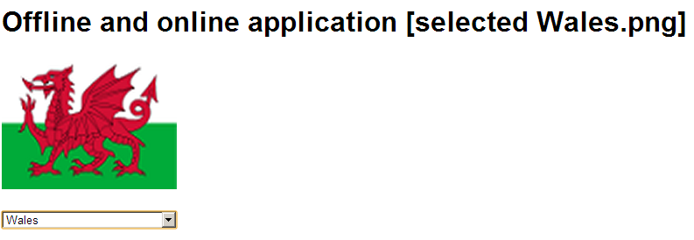
Example
For a worked example of offline storage, see:
OfflineWorking/OnOfflineApp.html
For detailed demo instructions, see:
OfflineWorking/Demo_OfflineWorking.docx
Notes:
This example shows how to set up an environment for offline working, and then how to observe the beneficial effects. The setup procedure for this demo is a bit tricky, so make sure you follow the demo instructions carefully.

Slide 27
Any Questions?

